Slide 1
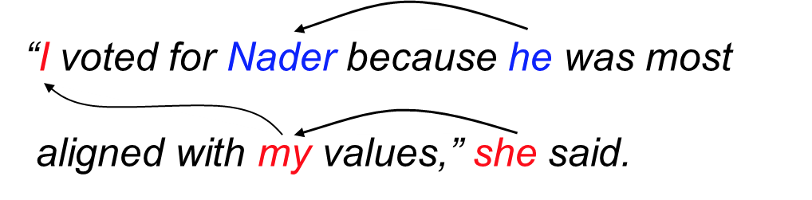
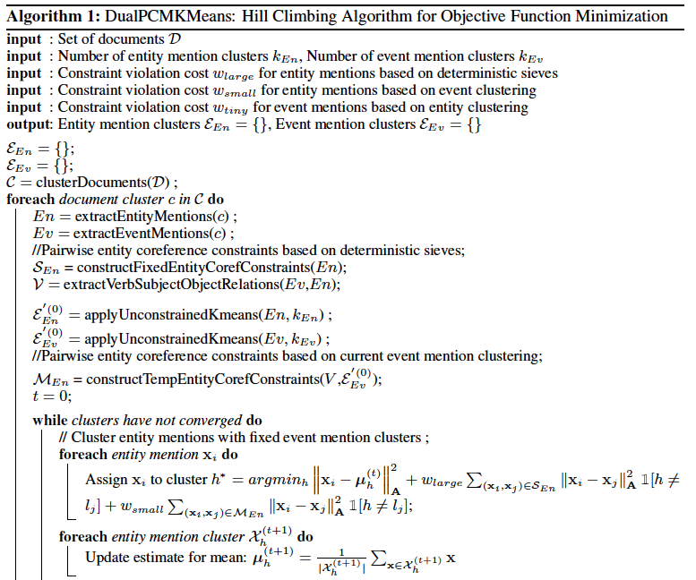
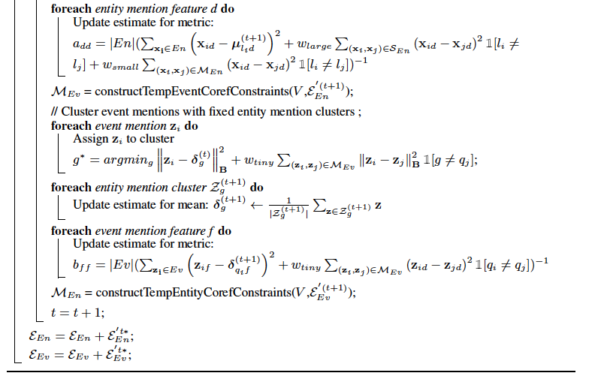
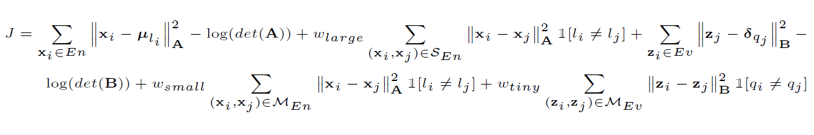
Joint Entity and Event Coreference Resolution with Minimal Supervision
Siddharth Goyal (sgoyal1@andrew.cmu.edu) and Sidharth Gupta (sidhartg@andrew.cmu.edu)
Carnegie Mellon University, Computer Science Department
INTRODUCTION
PROPOSED METHOD
RESULTS
Coreference resolution is the task of determining which mentions in text refer to the same real world identity.
Entity coreference resolution has been widely studied, employing techniques such as matching compatible noun pairs using semantic and syntactic features [1].
Event coreferece resolution is relatively unexplored, though techniques employing non-parametric Bayesian models [2], and spectral graph clustering have been proposed.
A common idea shared by many algorithms is to cluster mentions based on appropriately chosen features.
The interrelatedness of entity and event coreference resolution motivates a joint approach.
Open domain joint coreference resolution has only been studied recently by Lee et al. [3], who employ linear regression to learn a score function for hierarchical clustering.
But labelled data is difficult to acquire, which makes approaches requiring lower supervision more practical.
We address the problem using minimal supervision by introducing suitable must-link constraints, and adapting the soft constraint and metric based framework outlined by Bilenko [4].
FEATURE DESCRIPTION
The following features are combined to construct the entity/event feature vector, after vectorizing words using a pretrained model of Google word2vec:
Lexical features: Word2Vec features of headword and lemma, Depth of head word in dependency tree.
Class features: POS of head word, and word-class of head word.
Wordnet features: Category of WordNet lexicographer’s files associated with the head word.
Context features: Word2Vec features of 2 words to the left and 2 words to the right of the head of mention, and their POS tags.
Dependency features: If the head word is a dependent in a dependency relation, the label of relation is considered, in addition to dependency head word and its POS tag.
ALGORITHM
PROBLEM FORMULATION
Given a corpus of documents, they are first clustered to parition them into T topics. For each topic, entity and event mentions are extracted, and partitioned separately by clustering them using must-link constraints and an adaptive distance metric for feature scaling.
DATASET
We use the modified EventCorefBank (ECB) corpus [3]. It contains 482 documents from Google news clustered into 43 topics, and is annotated with entity and event coreference relations.
OBJECTIVE FUNCTION
REFERENCES
[1] Ponzetto, S. P., & Strube, M. (2006). Exploiting semantic role labeling, WordNet and Wikipedia for coreference resolution. In Proceedings of the main conference on Human Language Technology Conference of the North American Chapter of the Association of Computational Linguistics (pp. 192-199). Association for Computational Linguistics.
[2] Bejan, C., et al. (2009) "Nonparametric bayesian models for unsupervised event coreference resolution." Advances in Neural Information Processing Systems.
[3] Lee, H., et al. (2011). "Stanford's multi-pass sieve coreference resolution system at the CoNLL-2011 shared task." Proceedings of the Fifteenth Conference on Computational Natural Language Learning: Shared Task. Association for Computational Linguistics.
[4] Bilenko, M., Basu, S., & Mooney, R. J. (2004). Integrating constraints and metric learning in semi-supervised clustering. In Proceedings of the twenty-first international conference on Machine learning. ACM.

